Slide 1


Eco-B Point Application
Submitted By:
Group No: 66
Rohit Sanjay Patil-2123
Sayali Vikas Bhavsar-2164

Slide 2
Features
We Can Book Ride
Booking, request, ride end time is noted
Concept can be implemented at any residential area, park, office, college campus, etc

Slide 3
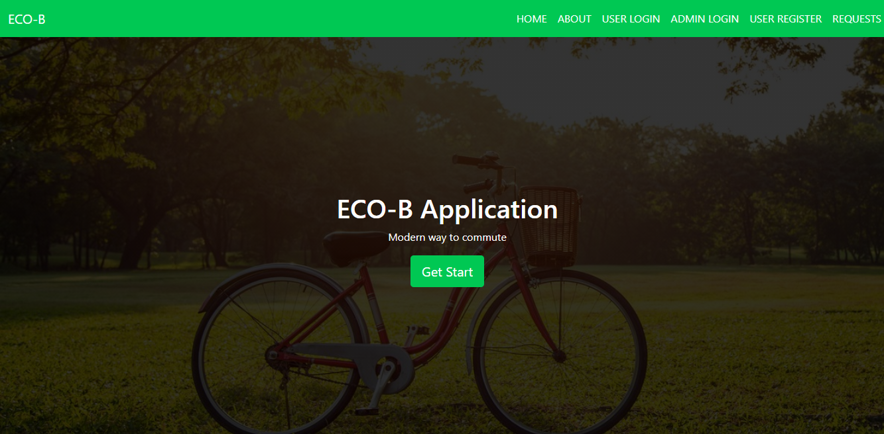
Screenshots
Home Page: this is welcome page for ECO-B application. Here you can find links for all of our services.

Slide 4
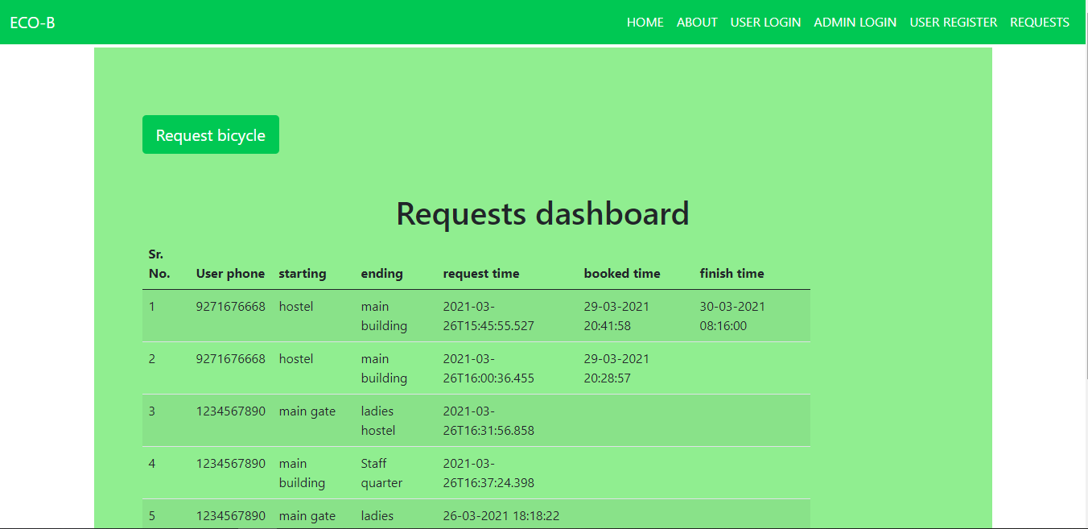
2.Request Dashboard: Here we can see all received requests and completed requests from users.

Slide 5
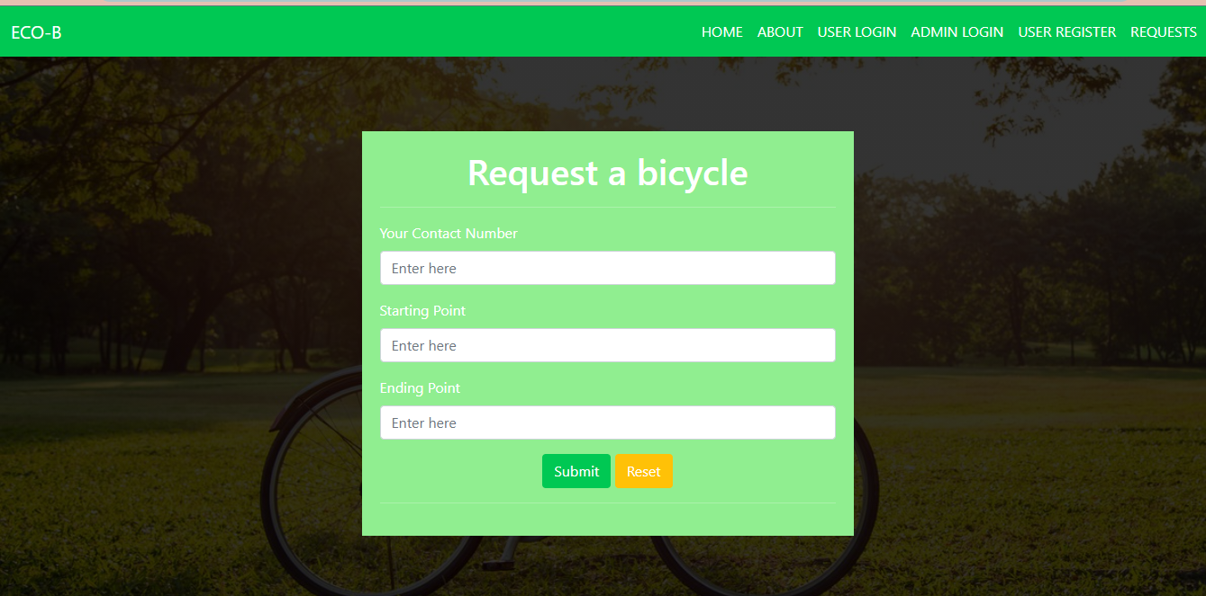
3. Request form: After clicking on request bicycle following menu shows up.

Slide 6
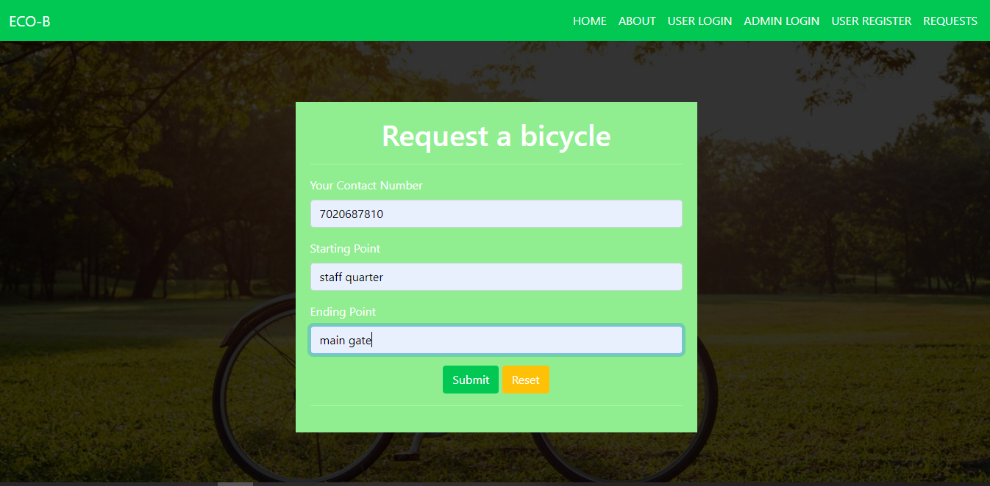
4. You can fill your details as given below.

Slide 7
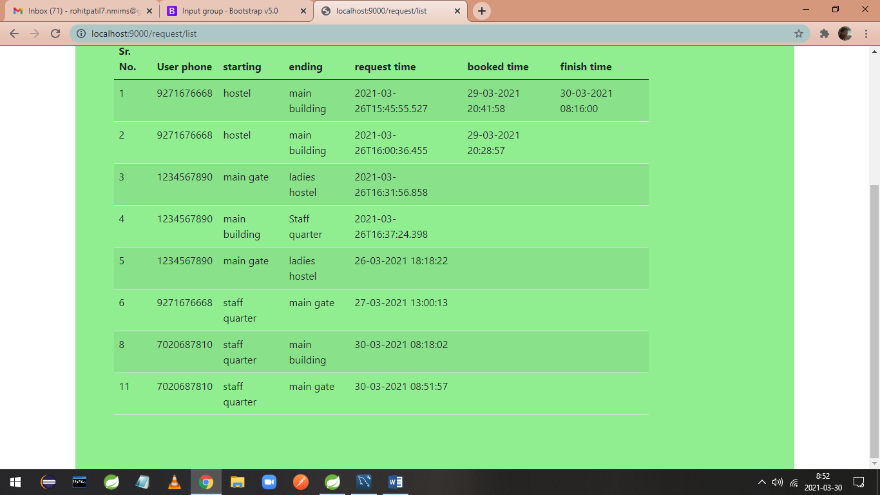
5. User request gets added in database as per details provided. Also request time is updated.

Slide 8
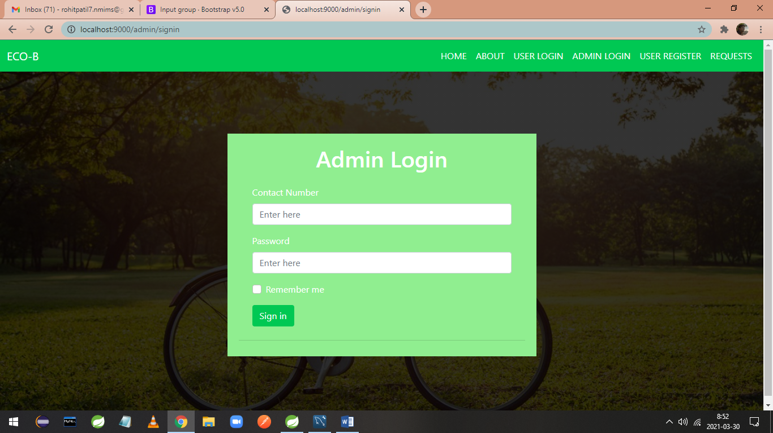
6. Admin login: now admin can login with his credentials, with help of admin login option.

Slide 9
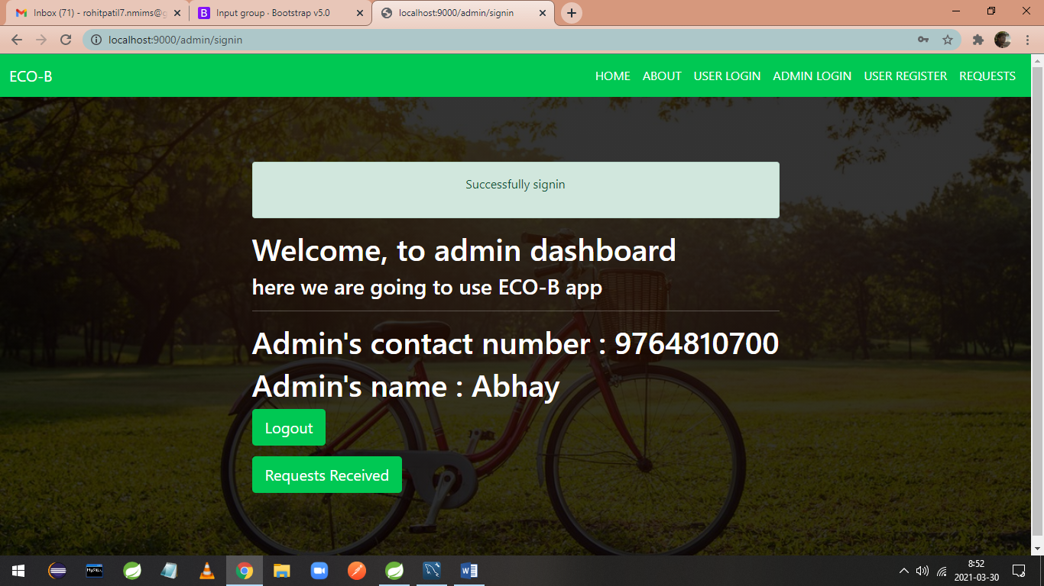
7. Admin dashboard: now admin is directed to admin dashboard. Where he has various options to see requests and logout.

Slide 10
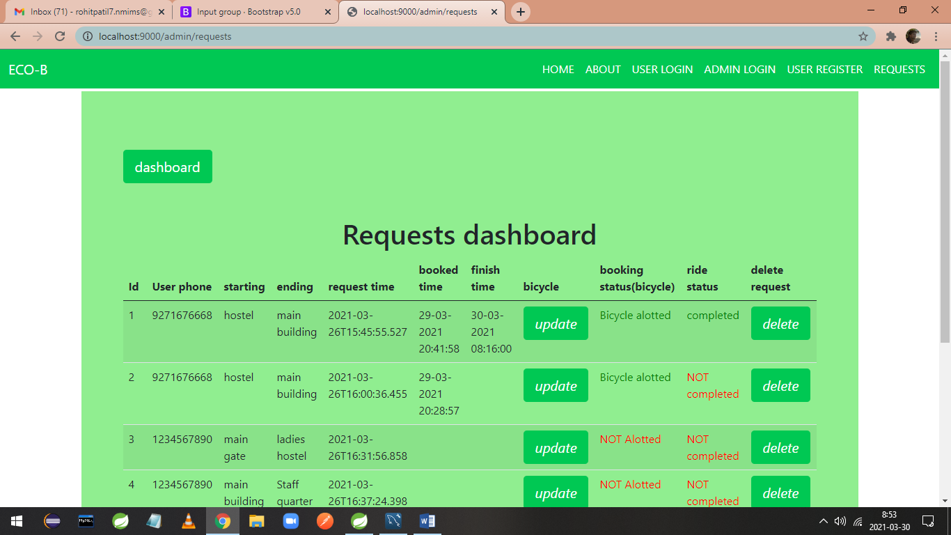
8. After clicking on requests received admin directed to request’s dashboard.

Slide 11
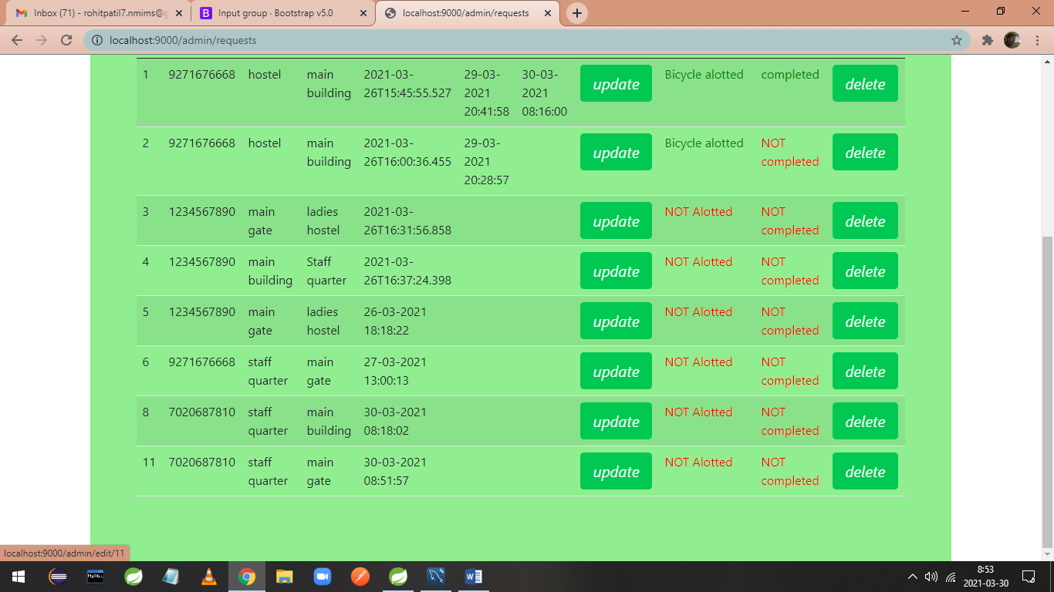
9. Here admin can click on update option to assign bicycle to user so user can take bicycle and start his ride.

Slide 12
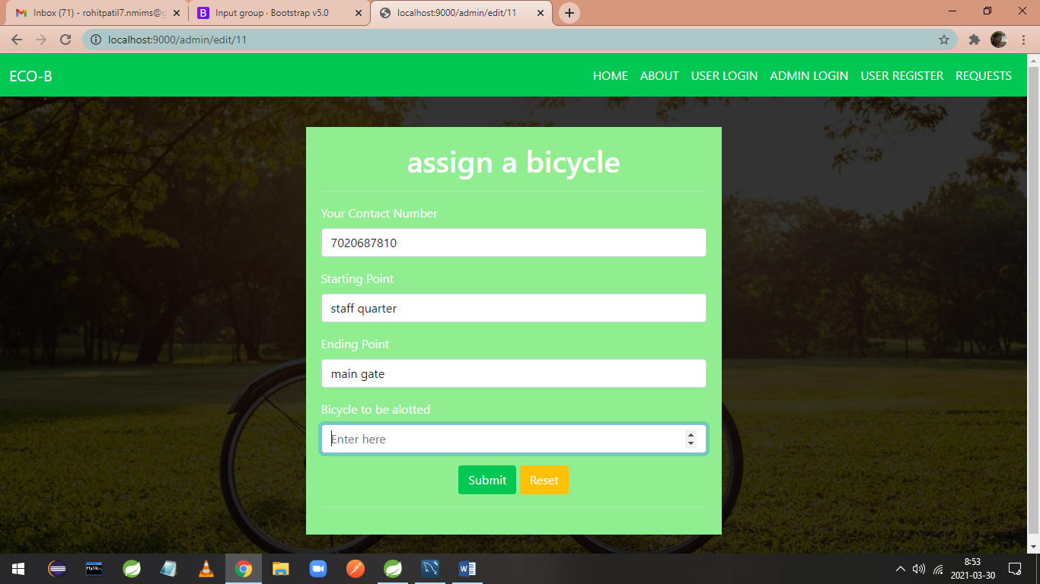
10. Assign form: here admin can edit bicycle for specific request.

Slide 13

11. After assigning bicycle admin can submit form.

Slide 14
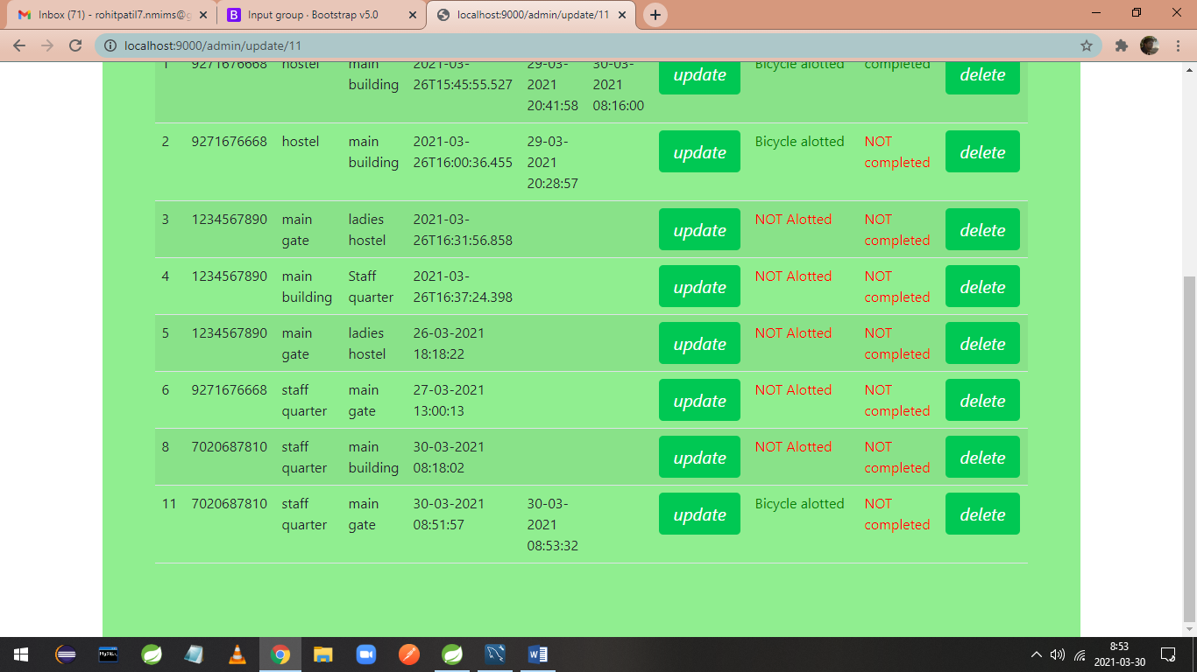
12. After assigning bicycle booked time updated for specific request.

Slide 15
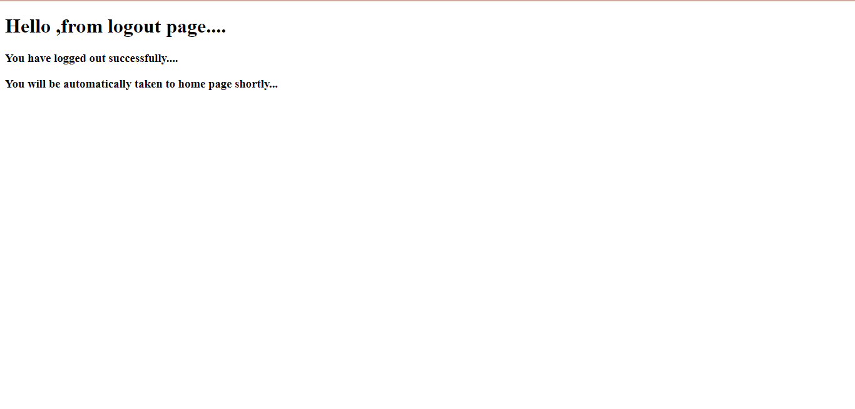
13. That’s all about admin role, now he can logout from admin dashboard. After 5 seconds you are automatically directed to homepage.

Slide 16
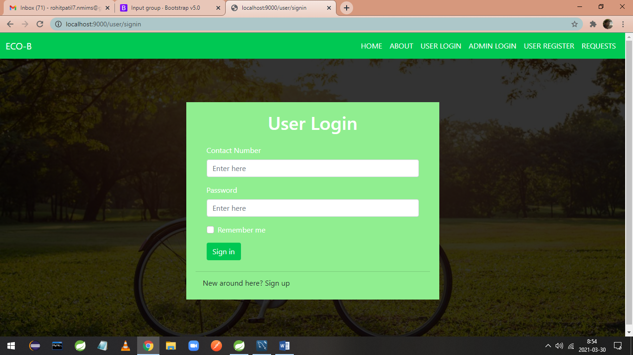
14. User can login with user login option.

Slide 17
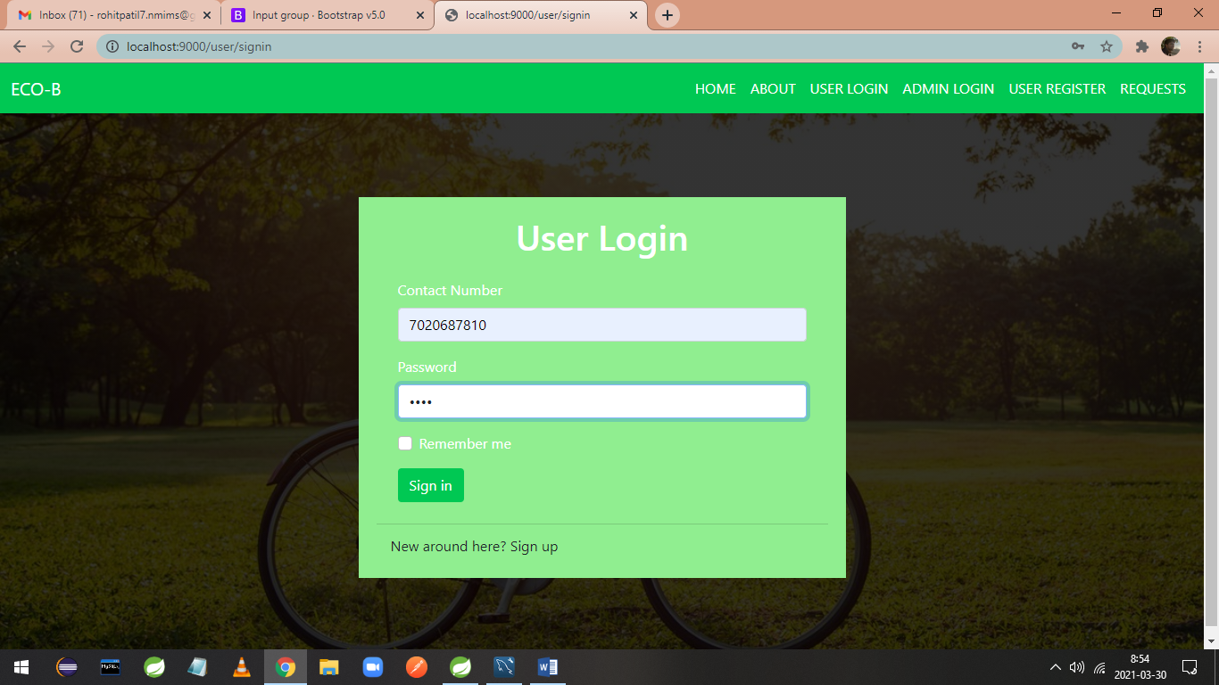
15. User can login with user credentials

Slide 18
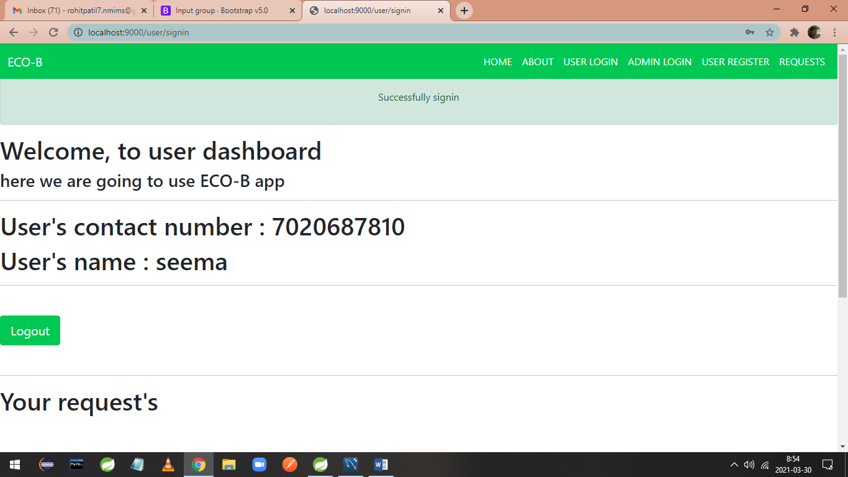
16. On success user is directed to his dashboard.

Slide 19
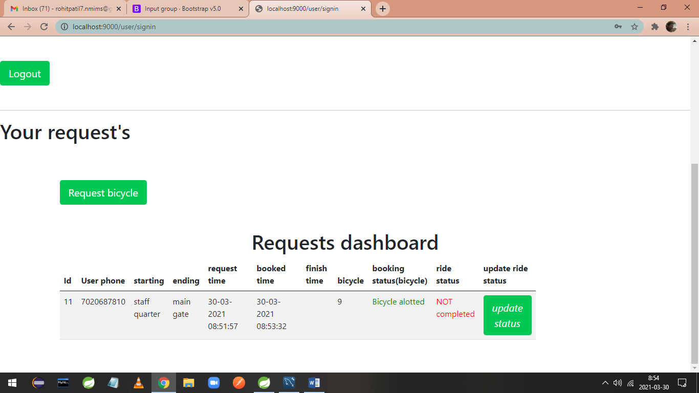
17. After scrolling user can see his approved and bicycle assigned request’s with bicycle id.

Slide 20
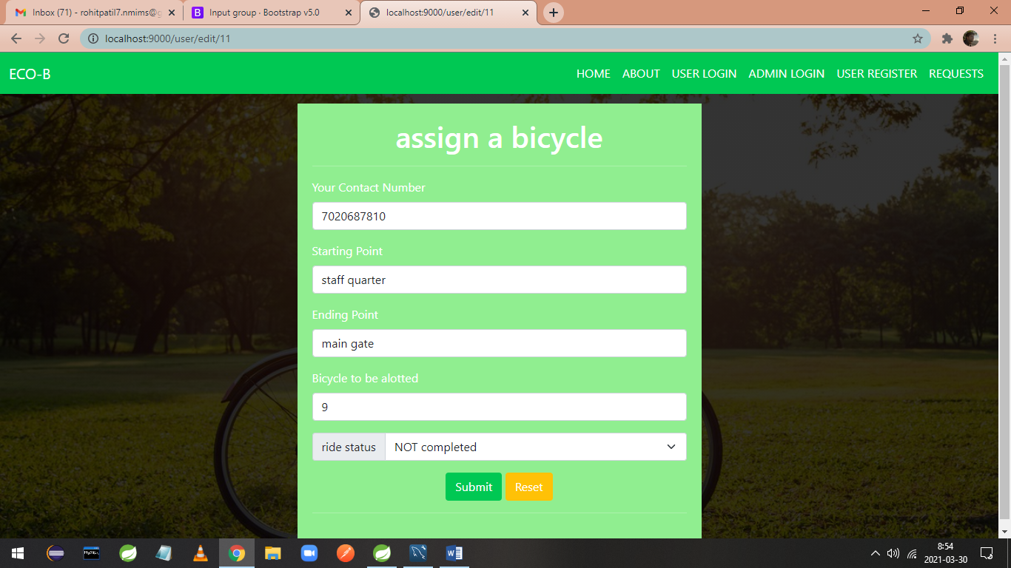
18. After clicking on update status user is directed to a form where he can give his ride finishing status.

Slide 21

19. Completed option is selected.

Slide 22
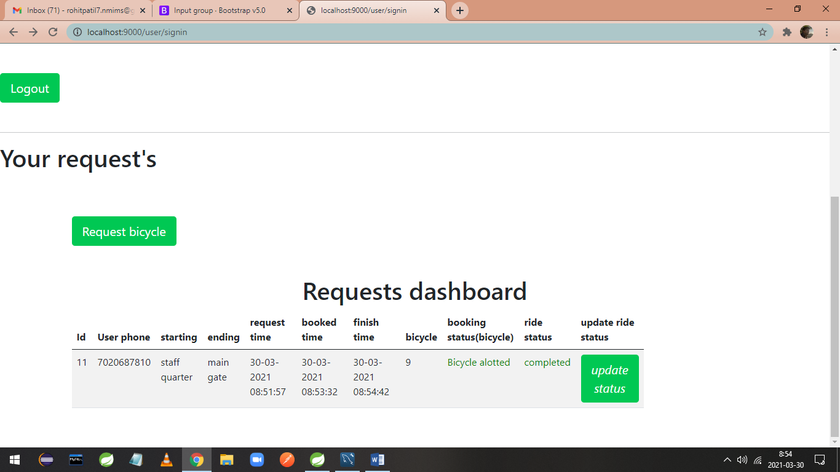
20. Ride status is updated as completed, with updated finish time. Now user can logout.

